Slide 1
Student Performance EDA

Slide 2
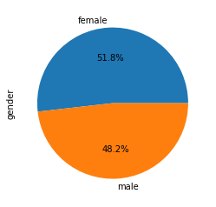
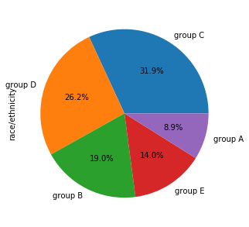
Proportion of Gender and the Race

Slide 3
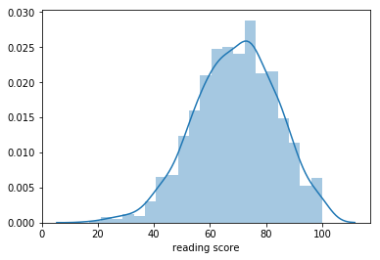
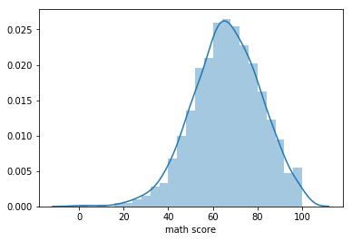
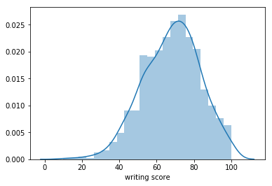
Distribution of the Marks

Slide 4
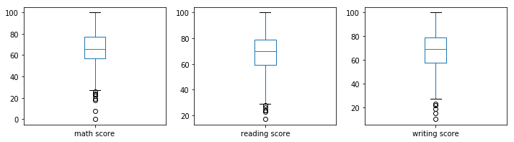
Box plot of the Marks
We can see the outliers in the graph. Basically there not outliers they are failed candidates.

Slide 5
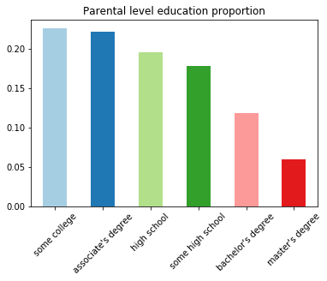
Education Level Proportion

Slide 6
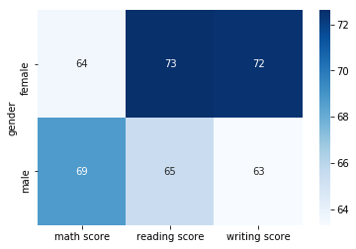
Mean score of Marks Gender wise

Slide 7
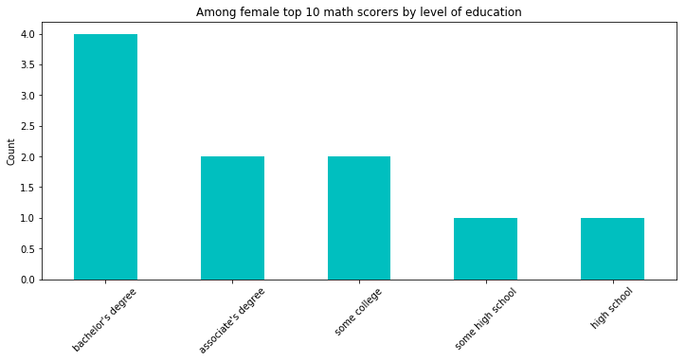
Top 10 Female scorers education level wise

Slide 8
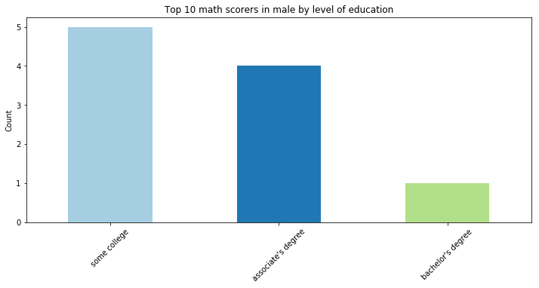
Top 10 male scorers education level wise

Slide 9
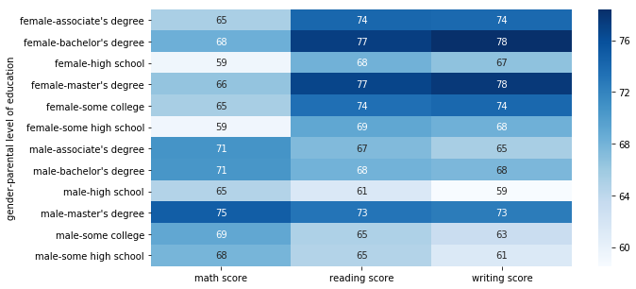
Gender and Education level wise Mean scores.
We can see that males are scoring good in math's.
Females are scoring good in reading and writing test.

Slide 10
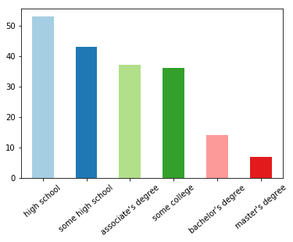
Education level wise F grade less than 60%

Slide 11
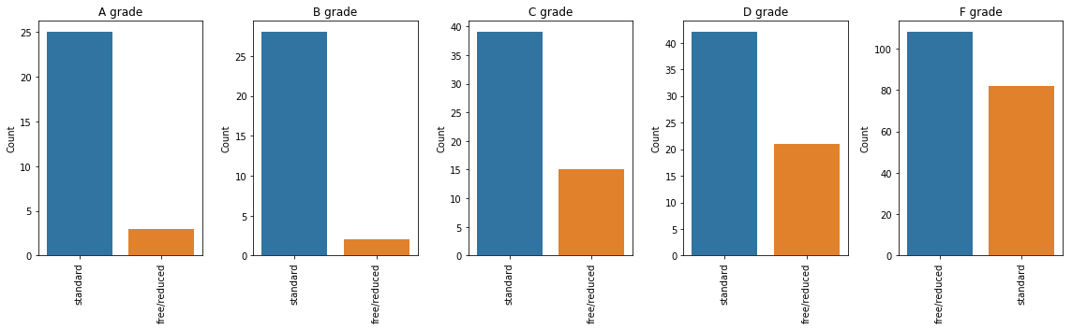
Grade in all the three subjects vs Lunch
As we can see from the graph is that the free/reduced lunch category is increasing as the grade is decreasing.

Slide 12
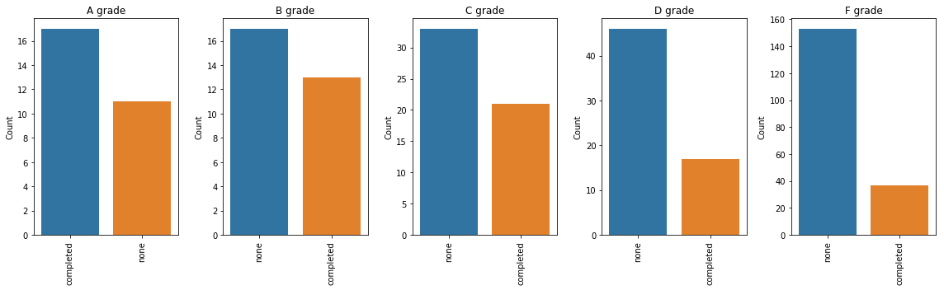
The students who has completed the test course is decreasing as the grades is decreasing.
The none is increasing as the grade is decreasing.

